Slide 1
THE LEBANESE INDUSTRIAL SECTOR : FACTS AND FINDINGS 2007
Beirut, 2010

Slide 2
Main Objectives
In 2008, the Ministry of Industry, with the support of the Association of the Lebanese Industrialists (ALI) and the UNIDO, launched a new study to assess the industrial sector’s performance.
The study’s main objective was to :
Conduct a census covering the large and medium industrial establishments (5 workers and more)
Collect descriptive and quantitative data on number and location of establishments, number of persons employed, compensation of employees, value of production and sales, input costs, energy expenses, inventory, investments, etc.
In a second phase, and based on this data collection, the Ministry will launch a national debate to initiate a new industrial strategy

Slide 3
Database
The database for the survey was prepared from different sources including information from previous surveys and from registers of the MoI, as well as from records of the Association of the Lebanese Industrialists (ALI) and other line ministries and organizations
The data base was enriched by additional manufacturing establishments administered by other ministries, such as pharmaceutical products or stone quarry
At the same time, the field surveyors were asked to address local authorities and to visit all industrial zones of the country

Slide 4
Outline
Section 1 – Main Features
Number of units
Location
Size of establishments
Workforce and its profile
Working area
Legal status and year of establishment
Adherence to a professional association
Section 2 – Quantitative Analysis
Industrial output
Intermediate consumption
Value added
Assets
Gross fixed capital formation
Salaries

Slide 5
Section 1 - Main Features

Slide 6
Number of Industries
According to the 2007 census results, Lebanon’s industrial sector counts 4,033 establishments, with 5 workers and more. This total excludes :
198 establishments that did not cooperate with surveyors,
The Tobacco public monopoly,
Public water and power establishments
Construction activities.
Industrial establishments registered after December 2007
Industrial establishments with less than 4 workers and with low fixed assets and sales, were considered as handicraft activities, and therefore were not included in this study.

Slide 7
Industries Location
Industrial units are not evenly distributed over the Lebanese territory. However the rural areas host an important number of large industrial operators.
Mohafaza | Beirut | Mount Lebanon | North Lebanon | Bekaa | South Lebanon | Nabatiyeh | Total
Number | 239 | 2,010 | 518 | 744 | 420 | 102 | 4,033
% of total | 5.9% | 49.8% | 12.8% | 18.4% | 10.4% | 2.5% | 100.0%
Average workers per establishment | 19 | 18 | 25 | 12 | 17 | 12 | 21

Slide 8
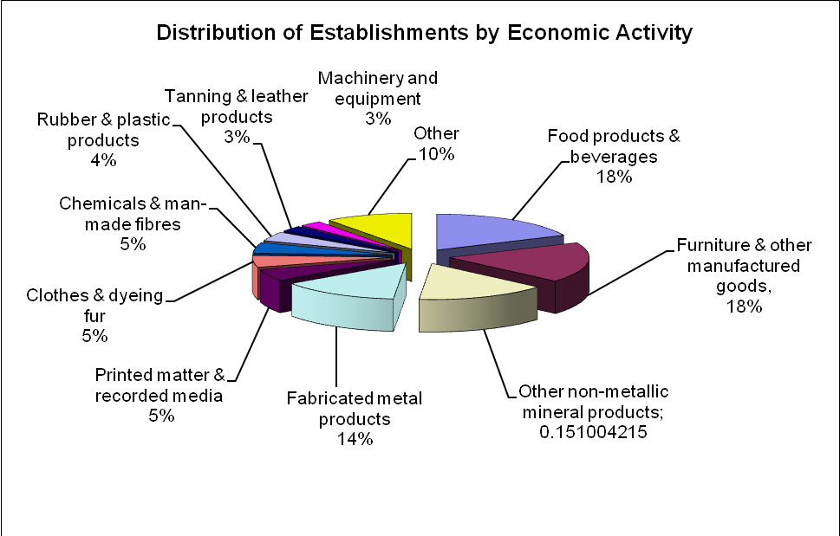
Main Industrial Activities
The Lebanese industry is not diversified. 10 major branches:
Group 86% of establishments
Generate 90.7 % of total value added
Employ 87.3% of the total workforce
Achieve 94.6% of the yearly industrial investments

Slide 9
Size of Industrial Units
The bulk of industrial establishments are small units.
78% employ between 5 and 19 workers
Only 3% employ more than 100 workers
Industries employing more than 50 workers represent 7.1% of total establishments…
…. but employ more than 45 % of the workforce
Class of workforce | Nb of establishments | Workforce
5-9 workers | 2,081 | 13,756
% of total industries | 51.6% | 16.6%
10-19 workers | 1,072 | 14,090
% of total industries | 26.6% | 17.0%
20-34 workers | 449 | 11,466
% of total industries | 11.1% | 13.8%
35-49 workers | 146 | 6,042
% of total industries | 3.6% | 7.3%
50-99 workers | 166 | 11,153
% of total industries | 4.1% | 13.5%
100-249 workers | 87 | 12,702
% of total industries | 2.2% | 15.3%
over 250 workers | 32 | 13,635
% of total industries | 0.8% | 16.5%
TOTAL | 4,033 | 82,843

Slide 10
Industrial Workforce
The 4,033 industrial establishments employ a total of 82,843 workers of which:
8,100 owners or partners
70,180 permanent employees
4,237 seasonal workers
326 outworkers
Only 17% of permanent employees are females
The average number of workers by unit is 21
The establishments employing from 5 to 19 workers represent 78.2% of the total number of establishments but only 33.6% of the total workforce

Slide 11
Industrial Workforce by industrial activity

Slide 12
Built Operating Area
The total built operating area is estimated at around 11.6 million m2, with an average built area per enterprise of 2,877 m2
However, 62 % of the industrial enterprises are operating in a space of around 915,000 m2 (364 m2 per unit)
78 establishments (1.9% of total establishments) occupying the largest areas (more than 20,000 m2) are using 46% of the total built operating area with an average space of 68,355 m2
Workforce by Class | Average worker per establish. | Average built area per establish. | Average built area per worker
5-9 | 7 | 806 | 115
10-19 | 13 | 2,121 | 163
20-34 | 26 | 3,817 | 147
35-49 | 41 | 3,570 | 87
50-99 | 67 | 7,286 | 109
100-249 | 146 | 22,234 | 152
≥ 250 | 426 | 70,962 | 167
Total | 21 | 2,877 | 137

Slide 13
Year of Establishment
The Lebanese industrial establishments are considered as new industries. 61.7% of the 4,033 establishments were established between 1990 and 2007.

Slide 14
Legal Status and Membership in Professional Associations
55% of industrial establishments are registered as individual establishments
20% are limited liability companies (S.A.R.L.)
11% are general partnerships (en commandite simple)
9% are limited companies (S.A.L.)
4% are limited partnerships
Less than 1% of establishments are registered in other legal form (cooperatives, limited by shares…)
45% of Lebanese industrialists are not registered at any professional or regional business association
58 % of establishments employing less than 10 workers are not members of any professional association This figure is 6% for companies employing more than 100 workers
The most reluctant establishments to participate in professional associations are those involved in construction materials

Slide 15
Section 2 – Quantitative Analysis

Slide 16
Industrial Output Highlights
The total industrial output for the 4,033 industrial establishments reached USD 6.8 billion in 2007
Average output per enterprise: USD 1,686,162 compared to USD 542,326 in 1998
Output per worker: USD 82,087
Largest share in total output
Food and beverage : 25.7%
Other non-metallic mineral products : 11.7%
Metal products: 10.9%
Main components of the output :
Sales from own production: 93.5%
Income from industrial and non industrial services: less than 1%
Variations in stocks for finished products or in progress: 2.7%
Value of electricity generated for own consumption: 2.8% of the total output

Slide 17
Intermediate Consumption
Total intermediate consumption (Out of which ) | USD 4.7 billion
Expenditures on raw materials and processed inputs | 85.30%
Stock variation | -3.30%
Share of expenditure on petroleum products for own production of electricity | 4.10%
Share of expenditure on electricity (from EDL) | 1.30%
Share of expenditure on energy products for production | 2.70%
Share of expenditure on maintenance | 2.40%
Share of other expenditures | 7.50%

Slide 18
Value Added
Total industry value added: USD 2.1 billion in 2007
Ratio of value added to output: 30.4%
Ratio of value added to output differed according to economic activity.
Lowest value: coke and refined petroleum products (4.9%)
Highest value: the mining and quarrying (55.2%)
Average value-added per worker equaled USD 24,927
Highest value: electrical machinery and apparatus sector (USD 61,786) compared to (USD 11,749) in the clothing sector and (USD 26,987) in the food and beverage industry
Ratio of value added to output varied according to the size of enterprises. Enterprises employing more than 250 workers had the greatest contribution to total value-added (26.2%). This contribution was higher than their share of output (21.8%)

Slide 19
Industrial Activity and Industrial Gross Margin
 |  | In (000) USD | In % of industrial output |  | In % value-added
Output |  | 6,800,292 | 100%
 | Value of goods produced | 6,360,332 |  | 93.5%
 | Services (industrial and non-industrial) | 63,624 |  | 0.9%
Intermediate Consumption |  | 4,735,290 | 69.5%
 | Net raw material | 3,882,518 |  | 57.1%
 | Electricity, energy products | 382,808 |  | 5.6%
 | Services and other operating costs | 469,963 |  | 6.9%
Value Added |  | 2,065,002 | 30.4%
 | Wages | 548,203 |  | 8.1% | 26.5%
 | Depreciation | 299,642 |  | 4.4% | 14.5%
 | Interest | 158,169 |  | 2.3% | 7.7%
 | Gross industrial margin | 1,058,988 |  | 15.6% | 51.3%

Slide 20
Salaries
Total salaries (including social contributions): USD 548 million
Average salary of a permanent employee: USD 7,492
Salaries varied by enterprise size. Average salary per employee is lowest in the small enterprises (USD 5,895) and highest in larger ones (USD 9,494)
Salaries varied by region. The lowest average salary per employee is in Nabatiyeh (USD 4,580) and the highest is in Mount Lebanon (USD 8,039)
Salaries are not homogeneous across economic activities
Salary per employee is lower than average in the food and beverage (USD 6,959), furniture (USD 6,561) and clothing (USD 5,131)
Salary per employee is higher than the average in the other non-metallic mineral products (USD 7,876), the printed matter and recorded media (USD 8,722) and electrical machinery and apparatus (USD 8,220)

Slide 21
Fixed Assets
At the end of 2007, total industrial fixed assets are estimated at USD 4 billion out of which :
Land: 19.8%
Buildings and other construction: 24.3%
Transport equipment : 4.0%
Computers and software: 1.2%
Machinery and equipment: 45.5%
Other fixed assets: 5%

Slide 22
Fixed Assets by Type of Investment

Slide 23
Fixed Assets by Region
 | Beirut | Mount Lebanon | North Lebanon | South Lebanon | Bekaa | Nabatiyeh | Total | Value assets (000) USD
Land | 2.40% | 56.20% | 22.10% | 3.20% | 15.60% | 0.40% | 100% | 793,286
Building | 4.10% | 58.60% | 13.30% | 5.20% | 18.20% | 0.70% | 100% | 973,298
Machinery | 2.90% | 63.50% | 18.90% | 2.70% | 11.30% | 0.70% | 100% | 1,818,707
Vehicles | 3.60% | 57.40% | 9.40% | 7.70% | 19.50% | 2.30% | 100% | 161,135
Computers | 4.90% | 81.20% | 5.70% | 2.00% | 5.80% | 0.30% | 100% | 46,953
Environmental equipment | 4.80% | 64.20% | 7.20% | 6.50% | 15.90% | 1.40% | 100% | 5,145
Other | 8.60% | 67.20% | 17.80% | 1.10% | 5.10% | 0.10% | 100% | 200,196
Total value of assets (000) USD | 137,619 | 2,439,769 | 702,426 | 140,828 | 551,970 | 26,109 |  | 3,998,720
Total Output (000) USD | 492,719 | 4,454,395 | 790,777 | 323,046 | 679,913 | 59,441 | 6,800,292
Output ( % of total) | 7.20% | 65.50% | 11.60% | 4.80% | 10.00% | 0.90% | 100%

Slide 24
Gross Fixed Capital Formation
Total gross fixed capital formation (G.F.C.F.) amounted to USD 296 million in 2007
Machines represent the largest share of G.F.C.F. (69.4%) and equipment for environment protection the smallest (0.1%)
Small companies employing between 5 and 9 workers have the lowest share of total gross fixed capital formation (3.1%).
Companies employing more than 250 workers has the highest share (36.5%)
The majority of G.F.C.F. is realized in two regions: North Lebanon (43.0%) and Mount Lebanon (45.6%)

Slide 25
Gross Fixed Capital Formation

Slide 26
Main industrial Aggregates

Slide 27
Geographical Distribution by Caza
Caza | Nb. of establish | As % of total | Workforce | As % of total | Area m² | As % of total | Output (000$) | As % of total
Matn | 1,101 | 27.3% | 21,136 | 25.5% | 1,497,970 | 12.9% | 1,546,303 | 22.7%
Zahleh | 337 | 8.4% | 8,056 | 9.7% | 1,150,582 | 9.9% | 463,106 | 6.8%
Aaley | 189 | 4.7% | 7,900 | 9.5% | 574,827 | 5.0% | 881,481 | 13.0%
Kessrwan | 173 | 4.3% | 7,092 | 8.6% | 622,907 | 5.4% | 644,138 | 9.5%
Baabda | 340 | 8.4% | 6,504 | 7.9% | 536,820 | 4.6% | 368,623 | 5.4%
Jbeil | 131 | 3.2% | 5,224 | 6.3% | 816,220 | 7.0% | 801,827 | 11.8%
Beirut | 239 | 5.9% | 4,509 | 5.4% | 231,399 | 2.0% | 492,719 | 7.2%
Baalbeck | 334 | 8.3% | 4,069 | 4.9% | 1,218,367 | 10.5% | 163,375 | 2.4%
Saida | 253 | 6.3% | 3,335 | 4.0% | 243,143 | 2.1% | 263,885 | 3.9%
Chouf | 76 | 1.9% | 2,567 | 3.1% | 1,352,733 | 11.7% | 212,024 | 3.1%
Tripoli | 149 | 3.7% | 2,322 | 2.8% | 79,475 | 0.7% | 67,294 | 1.0%
Batroun | 38 | 0.9% | 1,928 | 2.3% | 1,950,174 | 16.8% | 505,006 | 7.4%
Other Cazas | 673 | 16.7% | 8,205 | 9.9% | 1,326,342 | 10.6% | 390,512 | 5.7%
Total | 4,033 | 100% | 82,843 | 100.0% | 11,600,959 | 100% | 6,800,292 | 100%

